Slide 1
Feature Tracking by Two-Step Optimization
Team 11
Shashank Singh
Aman Choudhary
Ashish Shashikant Bokil

Slide 2
Problem Statement

Slide 3
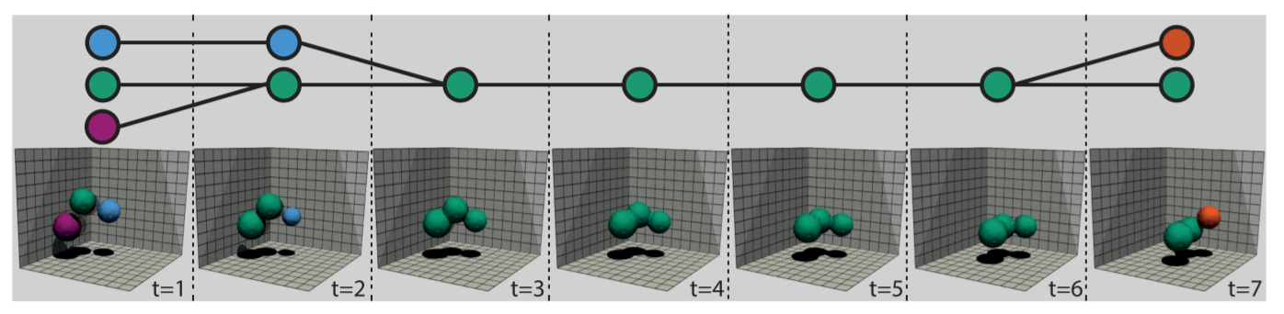
Aim : Feature Tracking
The goal of feature tracking is to algorithmically determine the temporal evolution of features in a series of data snapshots.
Typical examples of features include vortices, eddies, shocks, or topological structures
Feature tracking graph - The graph depicting how features evolve and change over time
Notes:
Show the final images folder

Slide 4
Types of events
1
A
Birth
2
B
Continuation
Split
3
C
4
D
E
Death
5
F
Merge

Slide 5
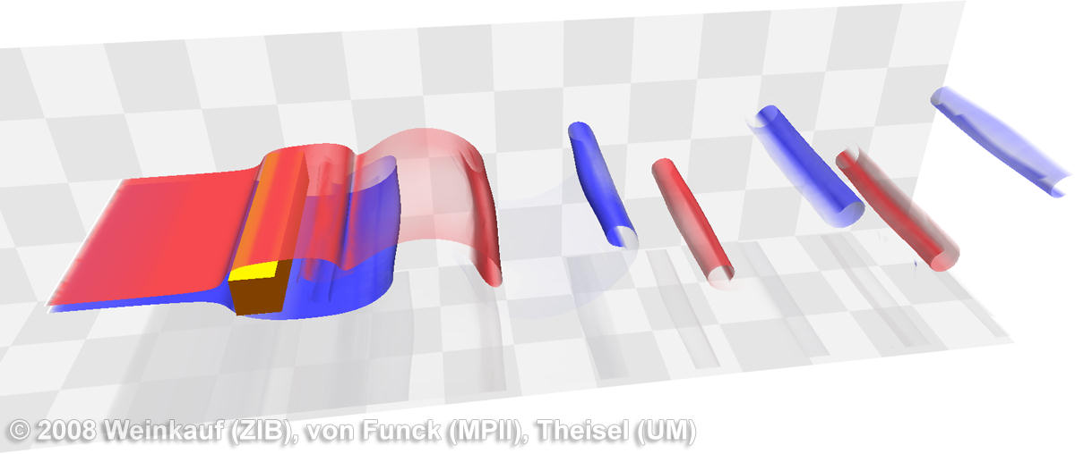
Dataset: 3D Flow Around a Confined Square Cylinder
508 time steps
Show the final output folder

Slide 6
Actual work done

Slide 7
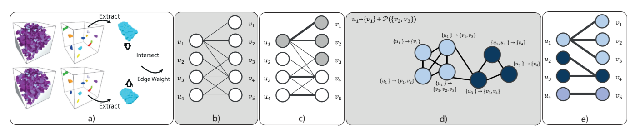
Solution Approach
a) Feature identification and extraction
b) Compute overlaps and generate bipartite graph
c) Find max-weight bipartite matching
d) Generate explanation graph
e) Find max-weight independent set
f) Add the merge, split edges based on previous step to the max-weight bipartite matching for final graph

Slide 8
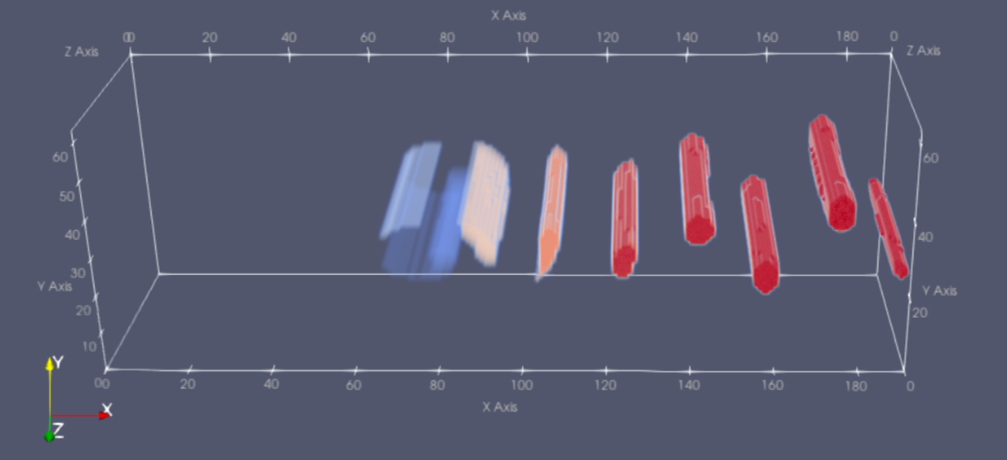
Feature identification and extraction
Used meshio library to process input vtk files for each timestep
Used OW(Okubo-Weiss) parameter with threshold 0.5 (selected by visual inspection) to identify connected points and classify them as one feature (vortex)
Figure showing extracted features from the dataset at one timestep
* In fluid mechanics, Okubo-Weiss parameter is a measure of the relative importance of deformation (shear) and rotation (vorticity) at a given point

Slide 9
Solution Approach
a) Feature identification and extraction
b) Compute overlaps and generate bipartite graph
c) Find max-weight bipartite matching
d) Generate explanation graph
e) Find max-weight independent set
f) Add the merge, split edges based on previous step to the max-weight bipartite matching for final graph

Slide 10
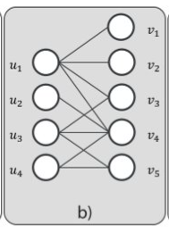
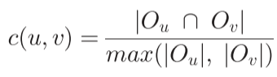
Constructing bipartite graph
For each consecutive timesteps t1 and t2, we construct a bipartite graph whose nodes are the features and edges represent volume overlap between them
When u is a node from timestep t1 and v from timestep t2, the normalized volume overlap parameter c(u, v) is calculated as follows :
O_{i} : Set of points that constitute a feature i

Slide 11
Solution Approach
a) Feature identification and extraction
b) Compute overlaps and generate bipartite graph
c) Find max-weight bipartite matching
d) Generate explanation graph
e) Find max-weight independent set
f) Add the merge, split edges based on previous step to the max-weight bipartite matching for final graph

Slide 12
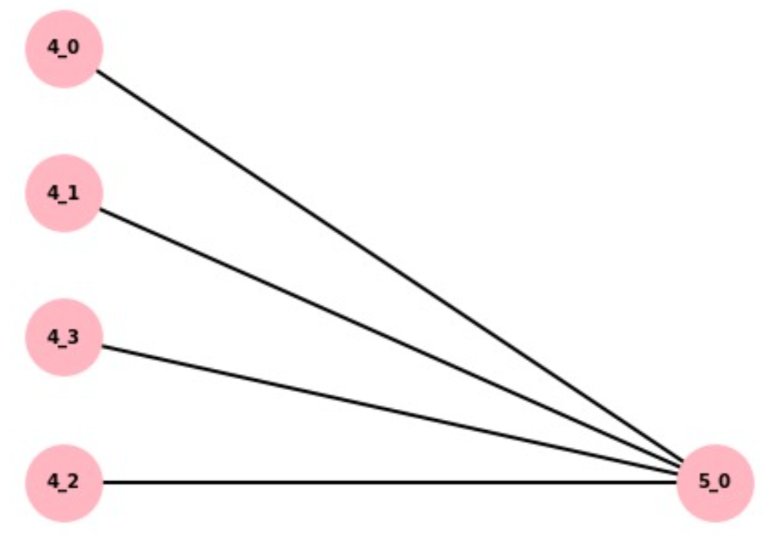
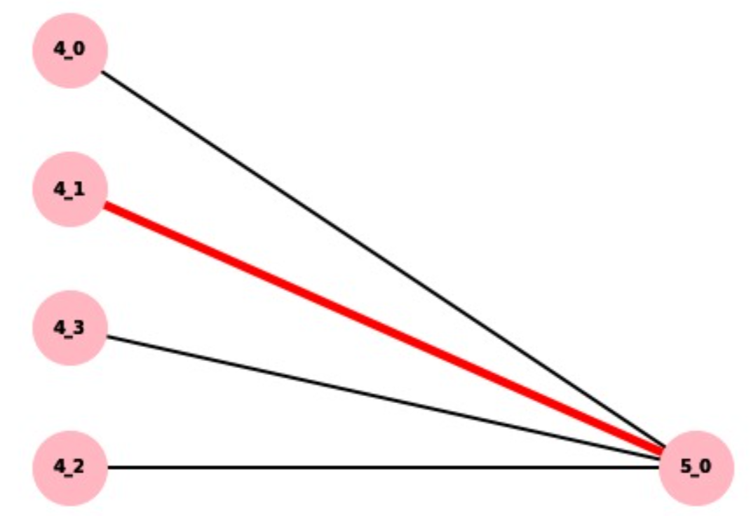
Maximum Bipartite Matching
NetworkX library, which uses Hungarian algorithm

Slide 13
Solution Approach
a) Feature identification and extraction
b) Compute overlaps and generate bipartite graph
c) Find max-weight bipartite matching
d) Generate explanation graph
e) Find max-weight independent set
f) Add the merge, split edges based on previous step to the max-weight bipartite matching for final graph

Slide 14
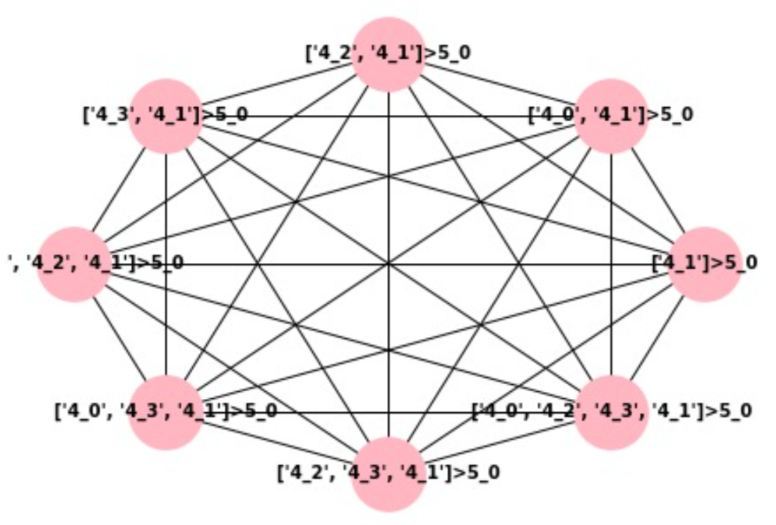
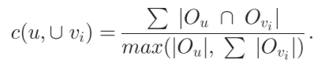
Explanation graph

Slide 15
Solution Approach
a) Feature identification and extraction
b) Compute overlaps and generate bipartite graph
c) Find max-weight bipartite matching
d) Generate explanation graph
e) Find max-weight independent set
f) Add the merge, split edges based on previous step to the max-weight bipartite matching for final graph

Slide 16
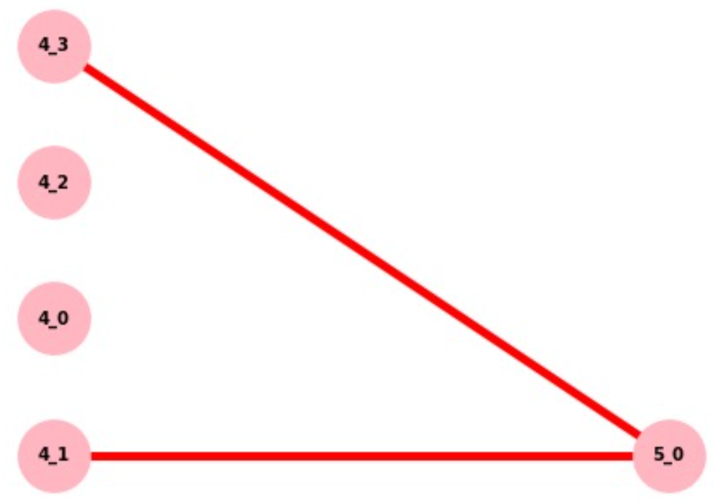
Maximum Independent set
Open source project KaMIS - Karlsruhe Maximum Independent Sets

Slide 17
Results

Slide 18
Table 1: Count of total events
Event | Total count (over 508 timesteps)
Continuations | 5281
Splits | 79
Merges | 12
Births | 141
Deaths | 202

Slide 19
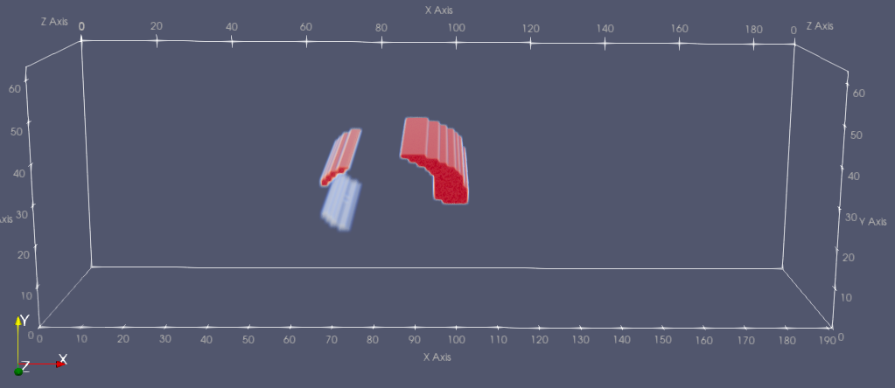
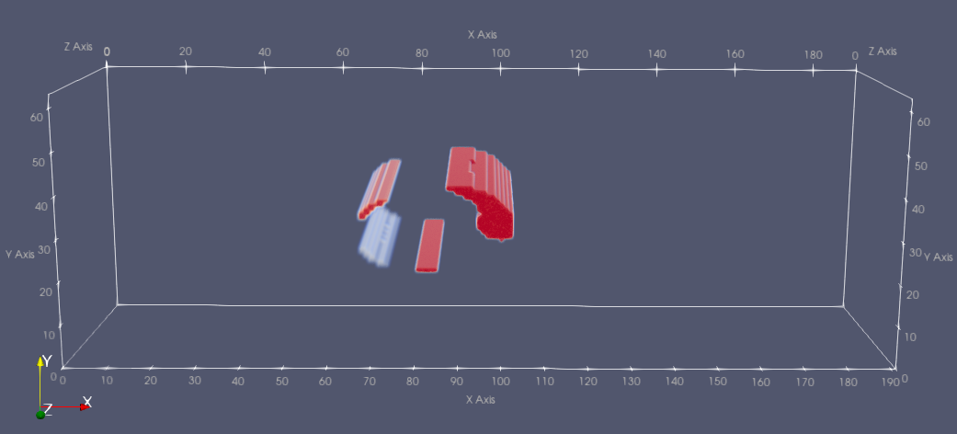
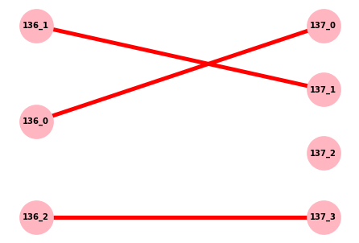
Sample pictures of events detected
Birth Event
T=136
T=137

Slide 20
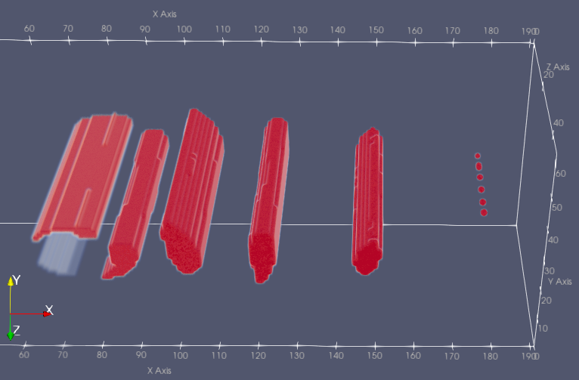
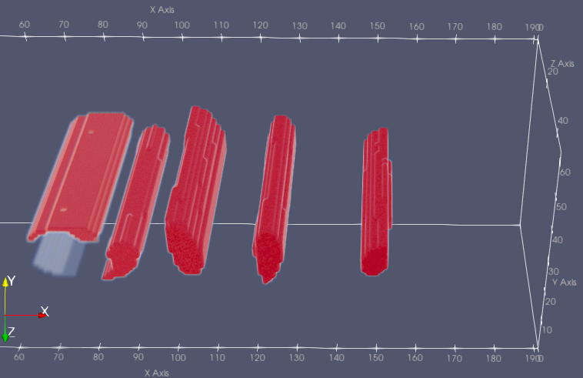
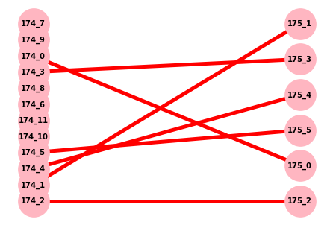
Sample pictures of events detected
Death Event
T=174
T=175

Slide 21
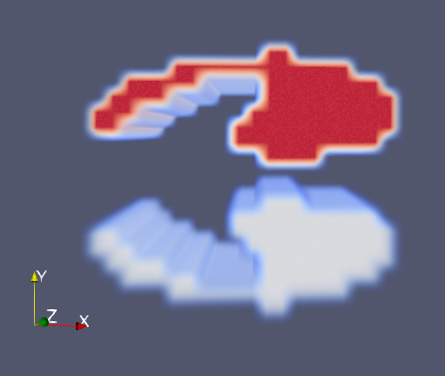
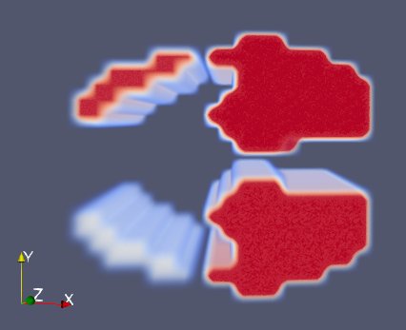
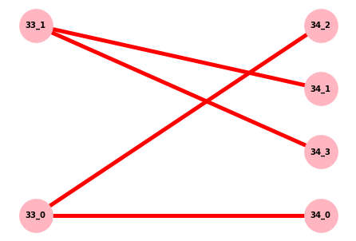
Sample pictures of events detected
Split Event
T=33
T=34

Slide 22
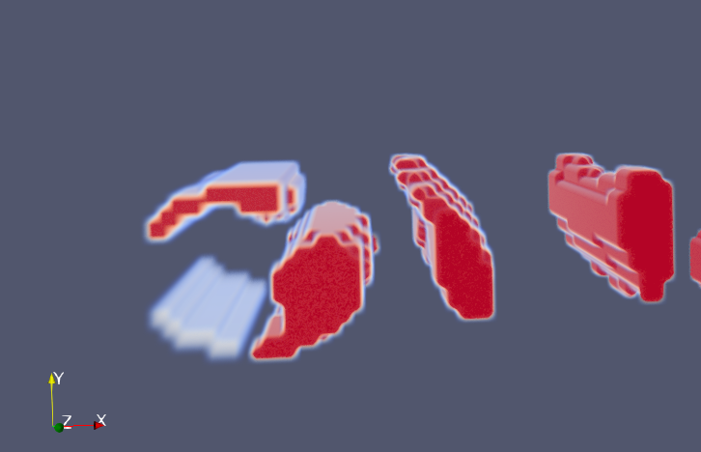
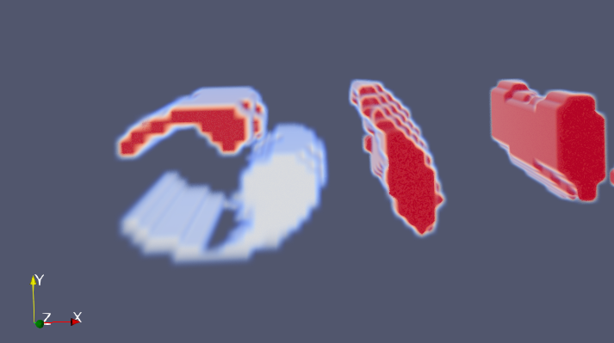
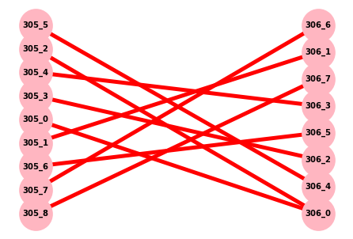
Sample pictures of events detected
Merge Event
T=305
T=306

Slide 23
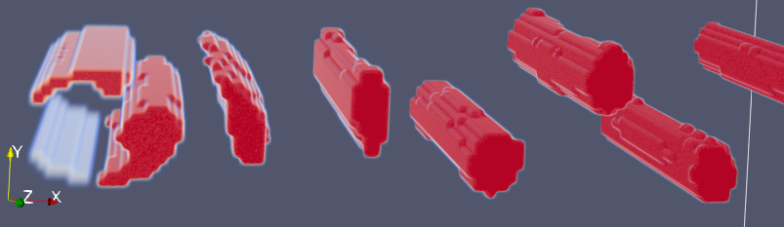
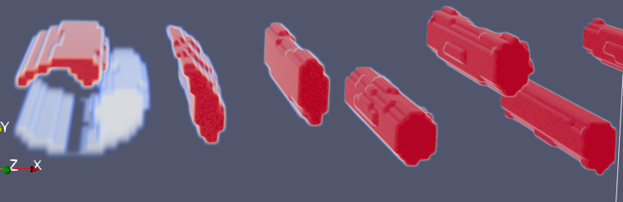
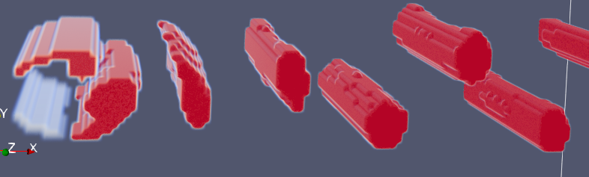
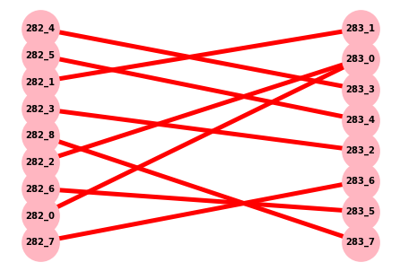
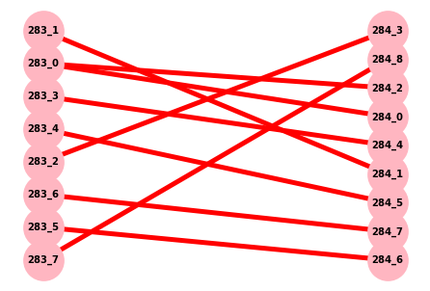
Feature tracking graph
T=282
T=283
T=284

Slide 24
Evaluation

Slide 25
Table 2: Time spent in different computations
Computation | Average Time taken (milliseconds)
Maximum weight bipartite matching | 10.79
Maximum weight independent set | 0.69
Total time/iteration | 590.53

Slide 26
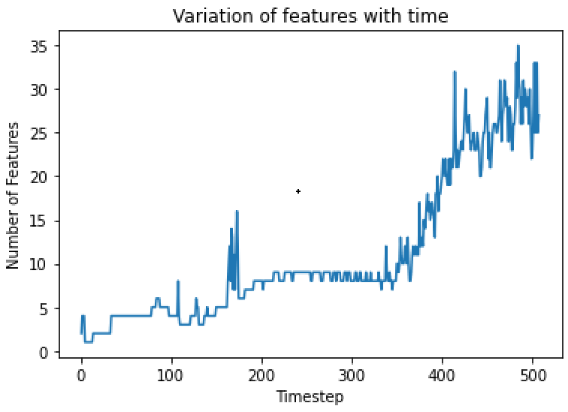
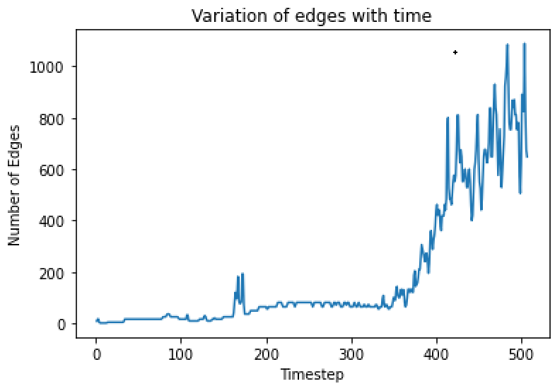
Variation of vertices(features)/edges in graph over time
All time values are in milliseconds (ms)

Slide 27
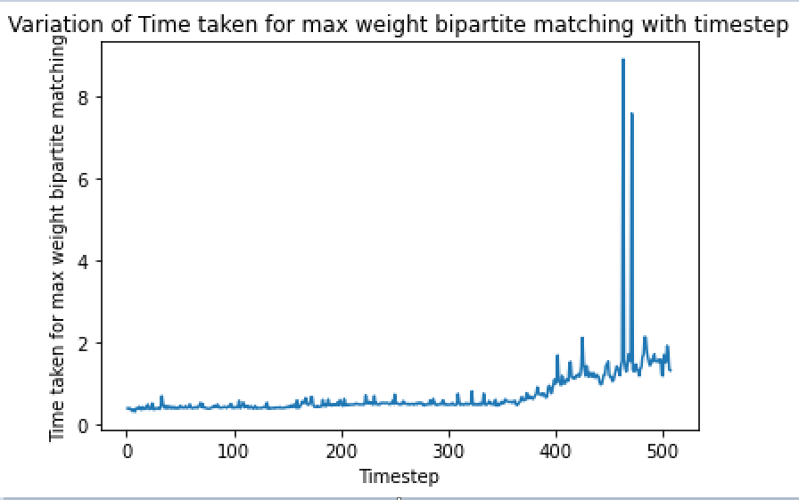
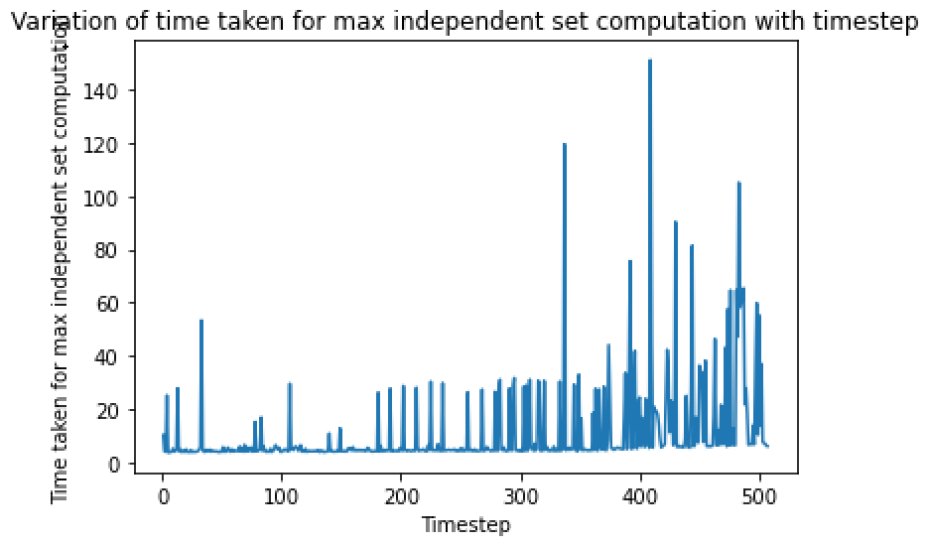
Variation of computation times
All time values are in milliseconds (ms)

Slide 28
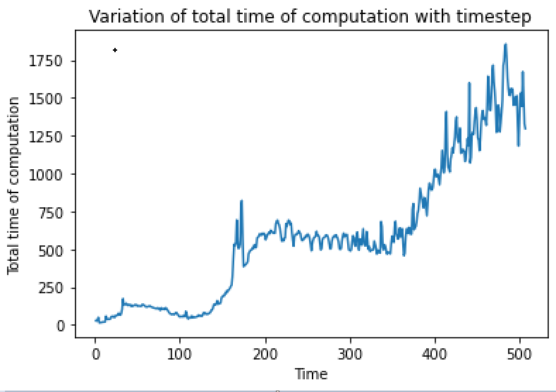
Variation of computation times
All time values are in milliseconds (ms)

Slide 29
Challenges faced
Extracting the features, and constructing the bipartite graph was a challenging task, as we had to finalize a suitable threshold value that would yield proper features.
We tried several threshold values and chose 0.5 as it appeared to have several events of interests in different time steps.
There was no ground truth data to validate the accuracy of our resulting events. We had to perform to visual inspection (using Paraview) to validate the events resulting from the method.

Slide 30
Conclusion
We were able to execute all the phases of the feature tracking
We could track all the events like births, deaths, splits, merges, continuations
In the vortex street dataset, continuations are the most frequent event and merges are the least frequent
The no. of extracted features in the graph is at max 50, so the dataset is sparsely space-filled.

Slide 31
Thank You

